Slide 1
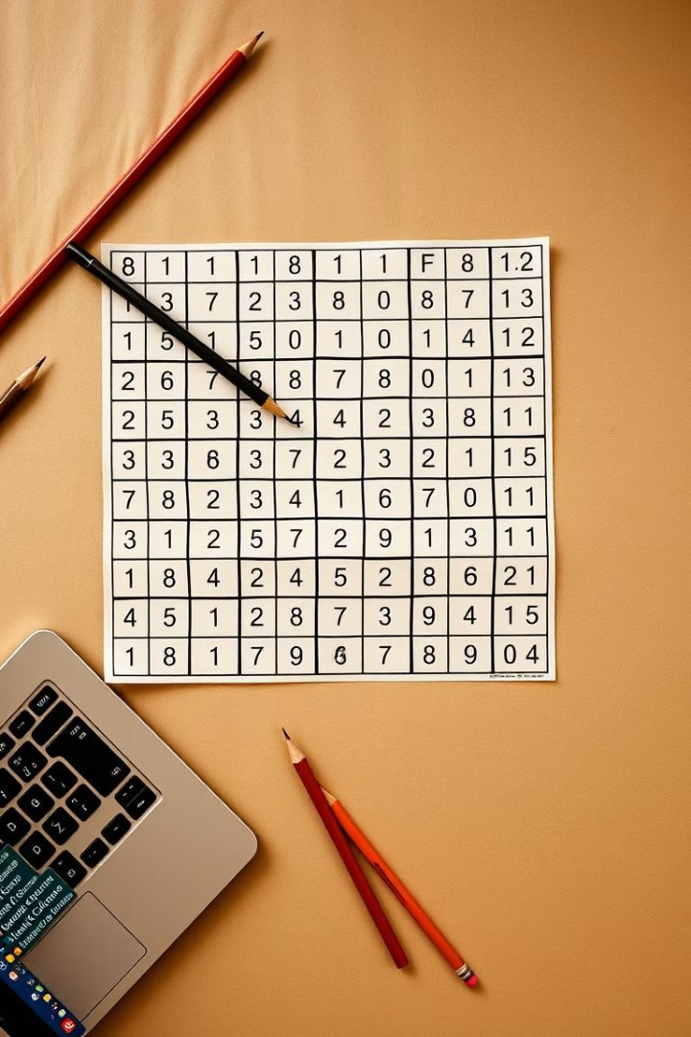

Cracking Sudoku: A Python AI Approach
Dive into the world of Sudoku solving with Python! Learn how to build an AI-powered solver using the backtracking algorithm. We'll cover everything from representing the grid to implementing the core logic. Explore the fascinating intersection of puzzles and programming.
by Akansha

Slide 2
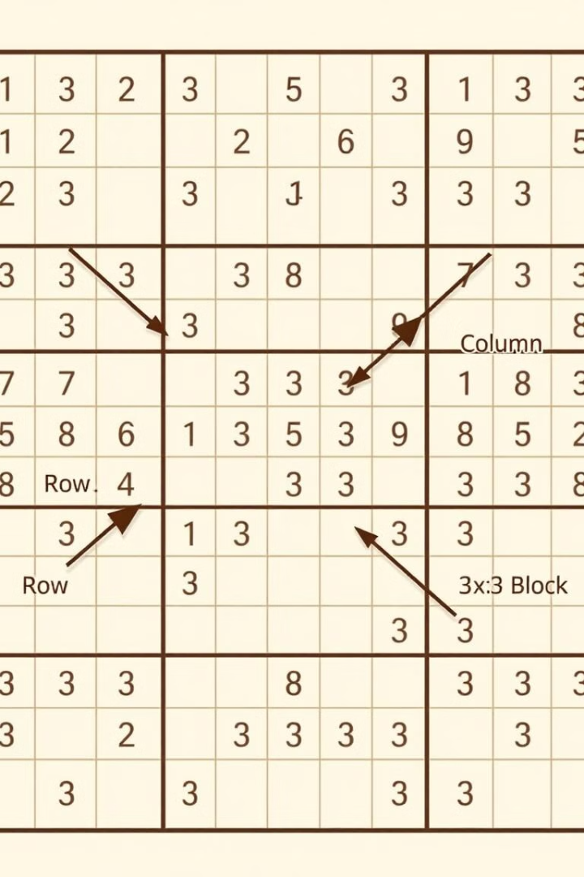
Representing the Sudoku Grid
Let's represent the Sudoku grid! We use a 2D array (list of lists) in Python. Zeros represent empty cells. Consider this example:
grid = [[5,3,0,0,7,...],[6,0,0,1,9,...],...]
Printing functions help visualize the grid, making the structure clear.
Rows
Columns
Horizontal lines of cells in the grid
Vertical lines of cells in the grid
Blocks
3x3 sections of the grid

Slide 3




Finding Empty Cells
First, we locate empty cells. The find_empty(grid) function iterates. It searches for a cell with a value of 0. It returns the row and column as a tuple. If no empty cells exist, the puzzle is solved.
Iterate
Loop through all cells.
Check
If cell == 0
Return
Index as Tuple

Slide 4
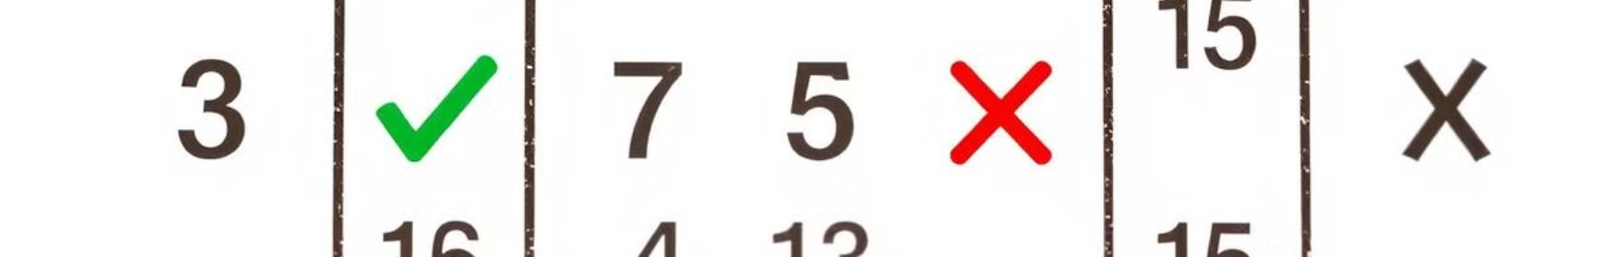



Validating Numbers
Next, is_valid(grid, num, pos) checks validity. It verifies if a number is valid in a position. It checks the row, column, and 3x3 box. It returns True if valid, False otherwise.
Row
No Duplicates
Column
No Duplicates
3x3 Box
No Duplicates

Slide 5
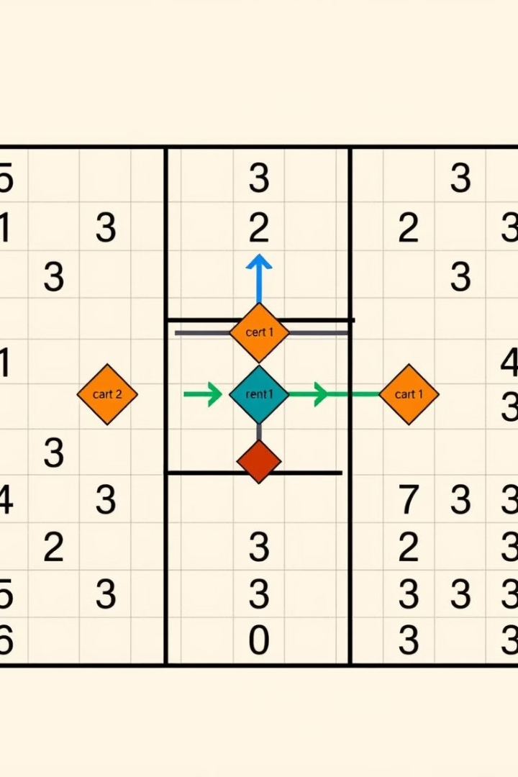

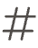

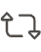
The Backtracking Algorithm
The solve(grid) function uses backtracking. It finds an empty cell using find_empty(). Tries numbers 1-9. If is_valid(), it places the number and calls solve() recursively. It backtracks if necessary, resetting the cell to 0. True means solved!
Find Empty Cell
Try 1-9
Validate
Recurse / Reset

Slide 6
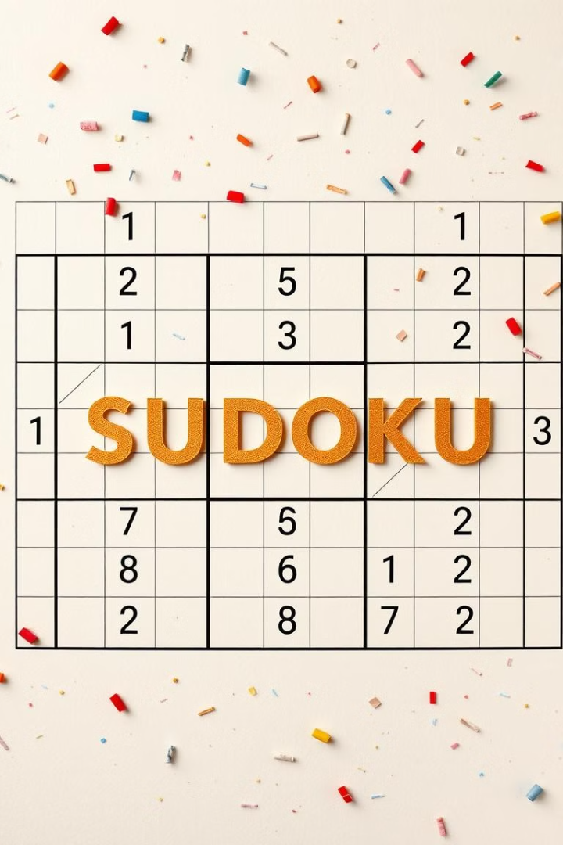
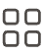


Sudoku Solver: Summary
We built a Sudoku solver using Python and backtracking! The program represents grids and validates moves. It uses recursion to find solutions.
Grid Representation
Validation
Using arrays
Checking moves
Backtracking
Solve Recursively

